Slide 1
Hardware Software Platforms Project Presentation
Measurement of temperature with tmp 100 sensor
Wautier Aurélien
Aurelien.WAUTIER@student.umons.ac.be

Slide 2
Purpose of the project
Measure the temperature thanks to the tmp 100 sensor
Display the temperature on a lcd screen

Slide 3
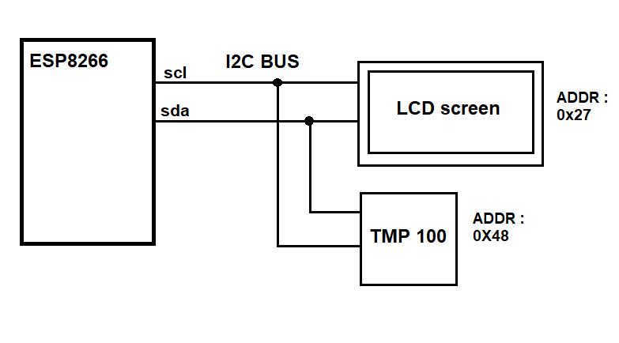
Schematic View

Slide 4
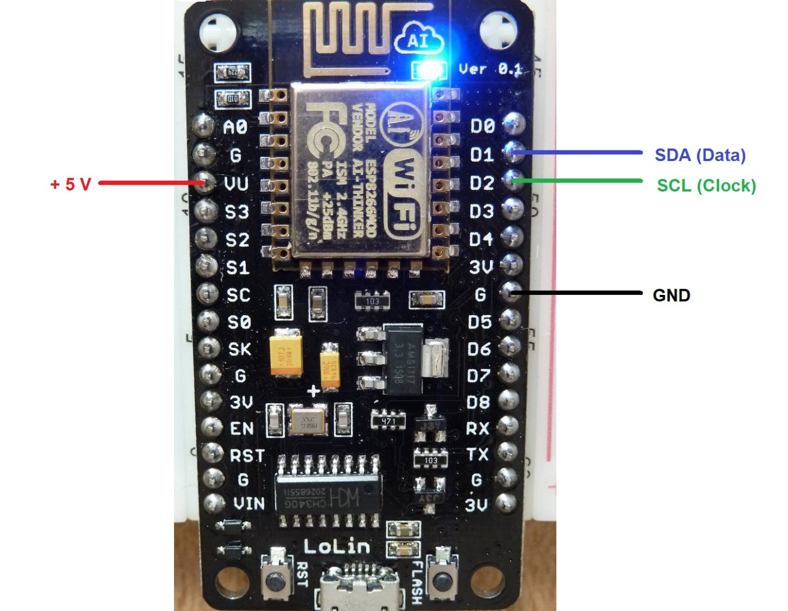
ESP8266
I2C

Slide 5
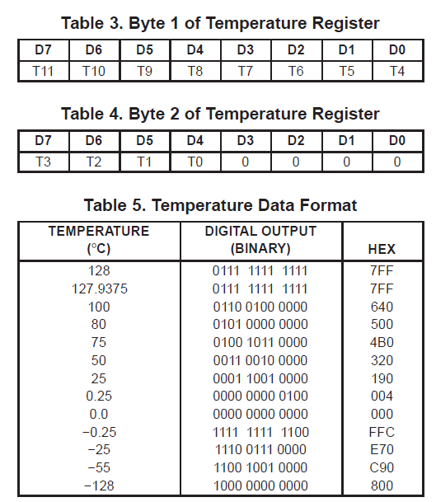
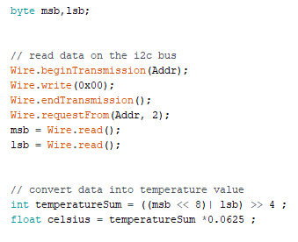
Collect data from tmp100

Slide 6
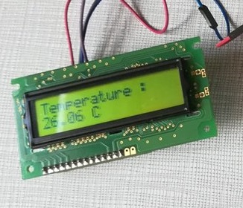
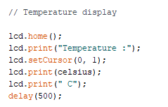
Display on the LCD Screen
Use the library LiquidCristal_I2C

Slide 7
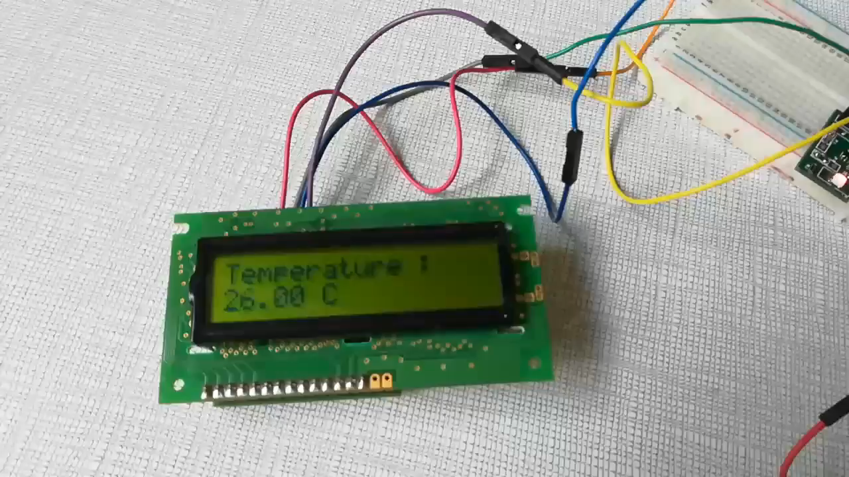
Demonstration

Slide 8
Questions ?

